Slide 1
Predicting the Programming Language of Questions and Snippets
of StackOverflow Using Natural Language Processing
Kamel Alreshedy, Dhanush Dharmaretnam, Daniel M. German, Venkatesh Srinivasan and T. Aaron Gulliver
Department of Computer Science, University of Victoria
Kamel, Dhanushd, dmg, srinivas@uvic.ca, agullive@ece.uvic.ca
Presented by
Turzo Ahsan Sami (ID: 20166012)
In partial fulfillment of the module
CSE-712: Natural Language Processing

Slide 2
Contents
Introduction
Related Work
Research Questions
Dataset Extraction & Processing
Methodology
Results
Shortcomings
Conclusion & Future Work
What I have learned reading this paper

Slide 3
Introduction
Stack Overflow:
The most popular Q/A website among programmers & software developers
Questions usually contain text body and code snippets
Relies on users to properly tag the programming language of a question
Groups questions based on tags
Chances of human error : New users may not tag their posts correctly
Without proper tags posts get downvoted and flagged by moderators
Questions related to frameworks and libraries may not have proper tags
Pandas is a Python library: it’s questions usually do not include a “Python” tag
Angular 2+ uses Typescript however it’s questions rarely have “Typescript” tag

Slide 4
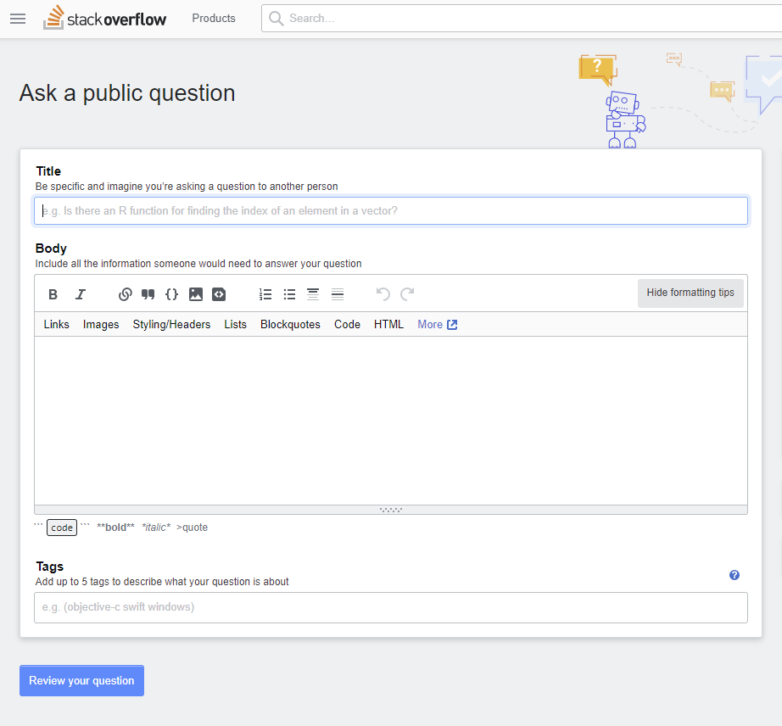
Introduction (continued)

Slide 5
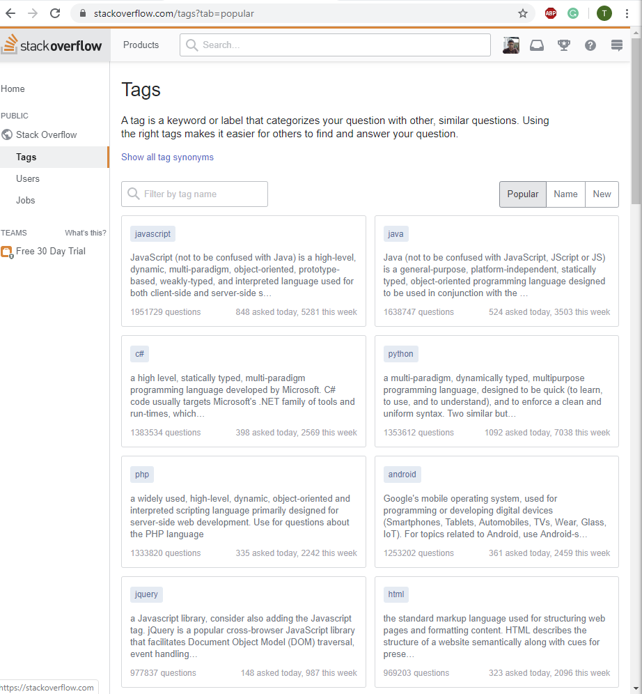
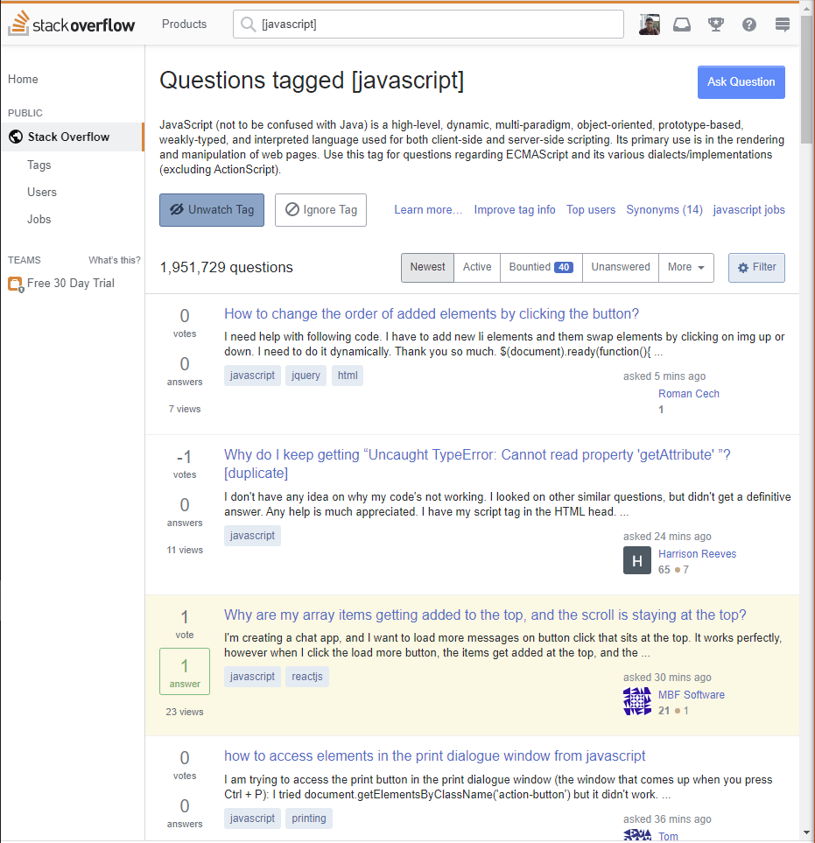
Introduction (continued)

Slide 6
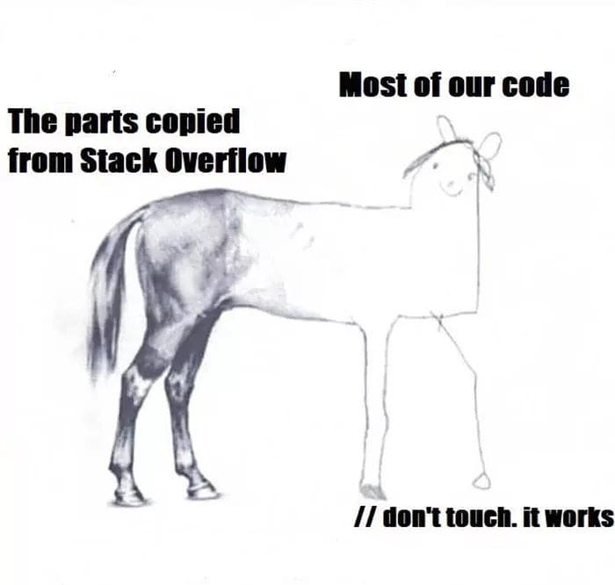
Introduction (continued)

Slide 7
Introduction (continued)
This paper proposes a classifier to predict programming language of questions asked on Stack Overflow using NLP and ML.
The classifier achieves an accuracy of 91.1% in predicting the 24 most popular programming languages.
Combined features from the title, body and the code snippets of the question.
The results demonstrate that it is possible to identify the programming language of a snippet of few lines of source code.

Slide 8
Related Works
J. F. Baquero, J. E. Camargo, F. Restrepo-Calle, J. H. Aponte, and F. A. González, “Predicting the Programming Language: Extracting Knowledge from Stack Overflow Posts” (2017)
Extracted a set of 18,000 questions from Stack Overflow.
Dataset contained both text and code snippets.
Trained two classifiers using a Support Vector Machine model.
Achieved an accuracy of 60% for text body features and 44% for code snippets.
J. Kennedy, V Dam and V. Zaytsev, “Software Language Identification with Natural Language Classifiers” (2016)
Identify the programming language of entire source code files from GitHub.
Classifier is based on five statistical language models from NLP.
Identifies 19 programming languages, with accuracy of 97.5%.

Slide 9
Related Works (continued)
J. N. Khasnabish, M. Sodhi, J. Deshmukh, and G. Srinivasaraghavan, “Detecting Programming Language from Source Code Using Bayesian Learning Techniques” (2014)
Proposed a model to detect 10 programming languages using source code files.
Achieved an accuracy of 93.48% using Multinomial Naive Bayes.
V. S. Rekha, N. Divya, and P. S. Bagavathi, “A Hybrid Autotagging System for StackOverflow Forum Questions” (2014)
Proposed a hybrid auto-tagging system that suggests tags to users proposed a hybrid auto-tagging system that suggests tags to users.
Multinomial Naive Bayes (MNB) was trained and tested for the proposed classifier which achieved 72% accuracy.

Slide 10
Research Questions
RQ1. Can we predict the programming language of a question in Stack Overflow?
RQ2. Can we predict the programming language of a question in Stack Overflow without using code snippets inside it?
RQ3. Can we predict the programming language of code snippets in Stack Overflow questions?

Slide 11
Research Questions (continued)
RQ1. Can we predict the programming language of a question in Stack Overflow?
Evaluate how machine learning performs when all the information in a Stack Overflow question is used.
Includes question’s title, body (textual information) and code snippets in it.

Slide 12
Research Questions (continued)
RQ2. Can we predict the programming language of a question in Stack Overflow without using code snippets inside it?
Determine whether the inclusion of code snippets is an essential factor to determine the programming language that a question refers to.
Includes textual information only, omitting the question title and code snippets.

Slide 13
Research Questions (continued)
RQ3. Can we predict the programming language of code snippets in Stack Overflow questions?
Evaluate the ability to use machine learning to predict the language of a snippet of source code.
Includes code snippets only.

Slide 14
Dataset Extraction & Processing
The Stack Overflow July 2017 data dump was used for analysis.
37.21 million posts, of which 14.45 million are questions with 50.9k different tags.
The most popular 24 programming languages as per the 2017 Stack Overflow developer survey were selected.
Constitute about 93% of the questions.
Selected languages: Assembly, C, C#, C++, CoffeeScript, Go, Groovy, Haskell, Java, JavaScript, Lua, Matlab, Objective-c, Perl, PHP, Python, R, Ruby, Scala, SQL, Swift, TypeScript, Vb.Net, Vba.

Slide 15
Dataset Extraction & Processing (continued)
Questions with more than one programming language tags were removed
Questions chosen contained at least one code snippet, and the code snippet had at least 10 characters
For each programming languages: approximately 10,000 random questions
The total number of questions selected was 232,727
XMLTODICT: parsed .xml data
Python Beautiful Soup: extract code and text separately from questions

Slide 16
Dataset Extraction & Processing (continued)
ML models cannot be trained on raw text because of noise present.
The textual information need to be preprocessed.
Preprocessing steps:
non-alphanumeric characters such as punctuation, numbers and symbols were removed
entity names were identified using the Spacy Library (https://spacy.io/)
stop words such as after, about, all, and, from etc. were removed
stemming and lemmatization- using the NLTK library in Python

Slide 17
Dataset Extraction & Processing (continued)
Dataset was split using the Tf-IDF vectorizer from the Scikit-learn library.
The Minimum Document Frequency (min-df) was set to 10.
only words present in at least ten documents were selected
Eliminates infrequent words from the dataset
ML models learn from the most important vocabulary
The Maximum Document Frequency (max-df) was set to default.
The datasets were split into training and test data using the ratio 80:20.

Slide 18
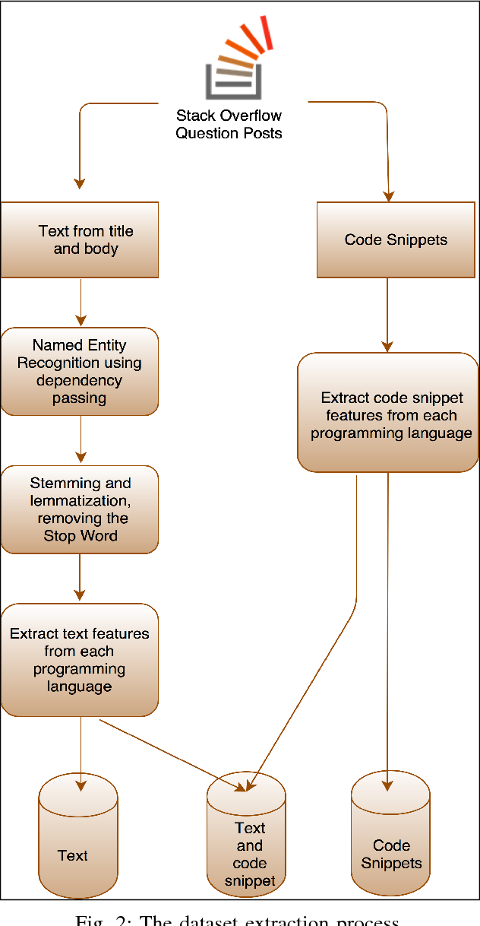
Dataset Extraction & Processing (continued)

Slide 19
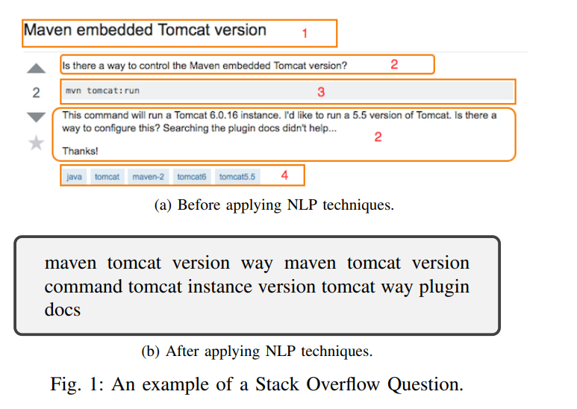
Dataset Extraction & Processing (continued)

Slide 20
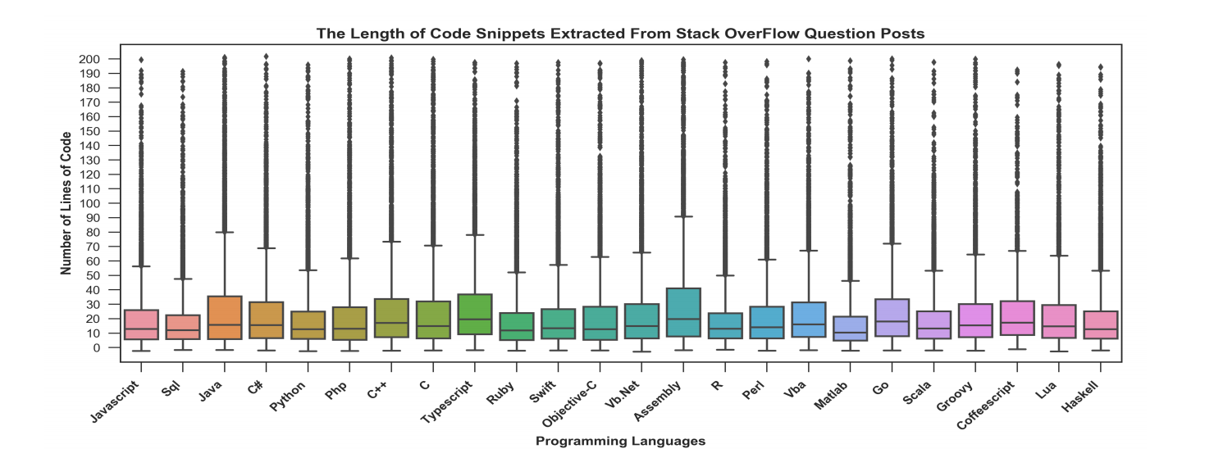
Dataset Extraction & Processing (continued)

Slide 21
Methodology (Classifiers)
Random Forest Classifier (RFC)
generates a number of decision trees from randomly selected subsets of training dataset
each subset provides a decision tree that votes to make the final decision
the final decision made depends on the decision of majority of trees (bagging)
a large number of trees in the forest give higher accuracy
if one or few of trees make a wrong decision, it will not affect the accuracy of the result significantly
avoids the overfitting problem seen in the Decision Tree model

Slide 22
Methodology (Classifiers)
Extreme Gradient Boosting (XGBoost)
A tree-based model similar to Decision Tree and RFC
Modifies the weak learner to be a better learner
Each subtree makes the prediction sequentially
Each subtree learns from the mistakes that were made by the previous subtree
Parameters: minimum child weight, max depth, L1 and L2 regularization
Parameters were tuned using RandomSearchCV of Scikit-learn library.

Slide 23
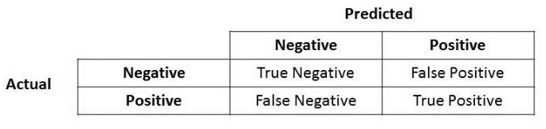

Evaluation metrics
Accuracy
= Correct predictions / Total predictions
= (TP + TN) / (TP + TN + FP + FN)
Precision
True positive / Total Predicted positive
= TP / (TP + FP)
Recall
True positive / Total Actual positive
= TP / (TP + FN)
F1 Score =

Slide 24
Results
RQ1. Can we predict the programming language of a question in Stack Overflow?
Highest F1 score: Swift (0.97), GO (0.97), Groovy (0.97) and Coffeescript (0.97)
Lowest F1 score: Java (0.75), SQL (0.78), C# (0.80) and Scala (0.88)
Classifier | Accuracy | Precision | Recall | F1 score
XGBoost | 91.1% | 0.91 | 0.91 | 0.91
RFC | 86.3% | 0.87 | 0.86 | 0.86

Slide 25
Results (continued)
RQ2. Can we predict the programming language of a question in Stack Overflow without using code snippets inside it?
10% decrease in accuracy
Highest F1 score: CoffeeScript (0.94), JavaScript (0.92), Swift (0.92), Go (0.92), Haskell (0.92), C (0.91) Objective-C (0.90) and Assembly (0.89)
Lowest F1 score: Java, SQL (25% decrease in accuracy)
Classifier | Accuracy | Precision | Recall | F1 score
XGBoost | 81.1% | 0.83 | 0.81 | 0.81
RFC | 75.6% | 0. 76 | 0.74 | 0.75

Slide 26
Results (continued)
RQ3. Can we predict the programming language of code snippets in Stack Overflow questions?
When the programming language of a code snippet is extremely hard to identity,
XGBoost frequently misclassified it as Objective-C,
RFC misclassified such snippets as Typescript.
Highest F1 score: JavaScript (0.91), CoffeeScript (0.89) and PHP (.88)
Objective-C has the worst F1 score and precision (0.56 and 0.42);
Classifier | Accuracy | Precision | Recall | F1 score
XGBoost | 77.7% | 0.79 | 0.77 | 0.77
RFC | 70.1% | 0.72 | 0.72 | 0.70

Slide 27
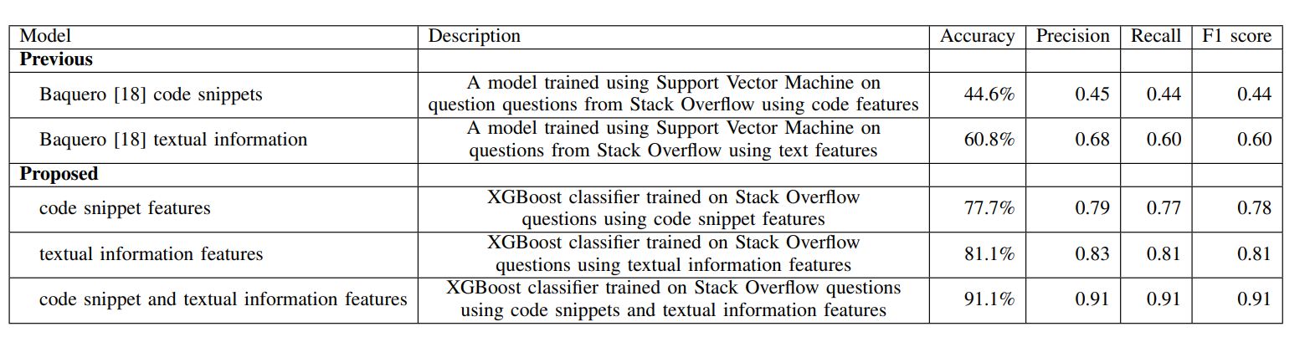
Results (continued)

Slide 28
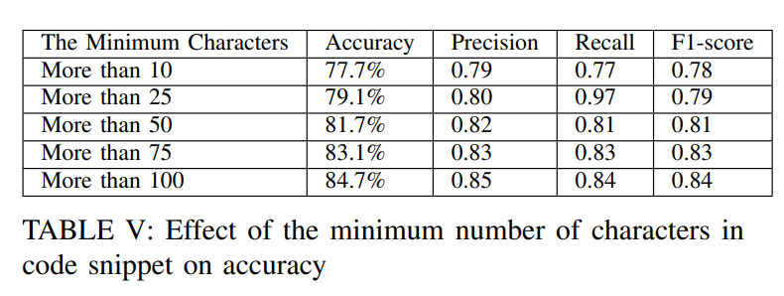
Results (continued)

Slide 29
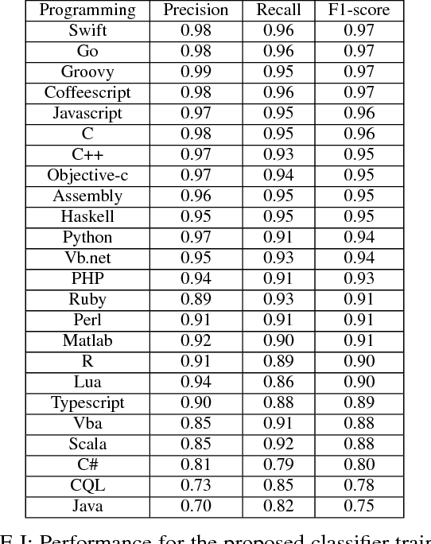
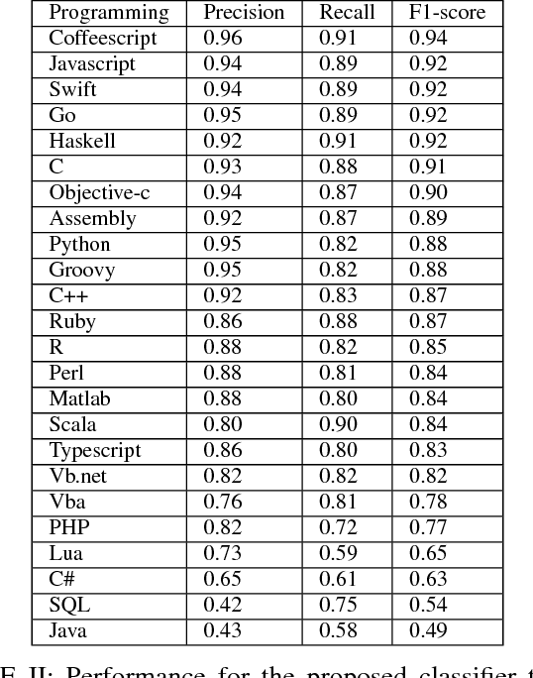
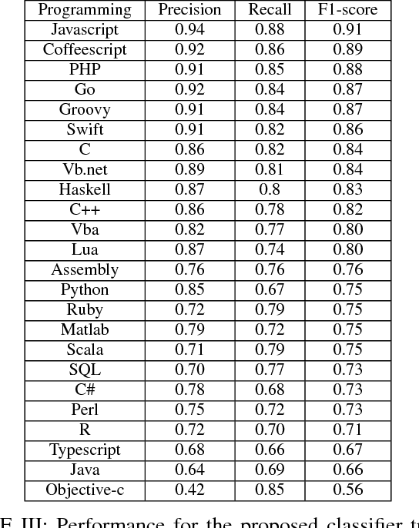
Results (continued)
RQ1
RQ2
RQ3

Slide 30
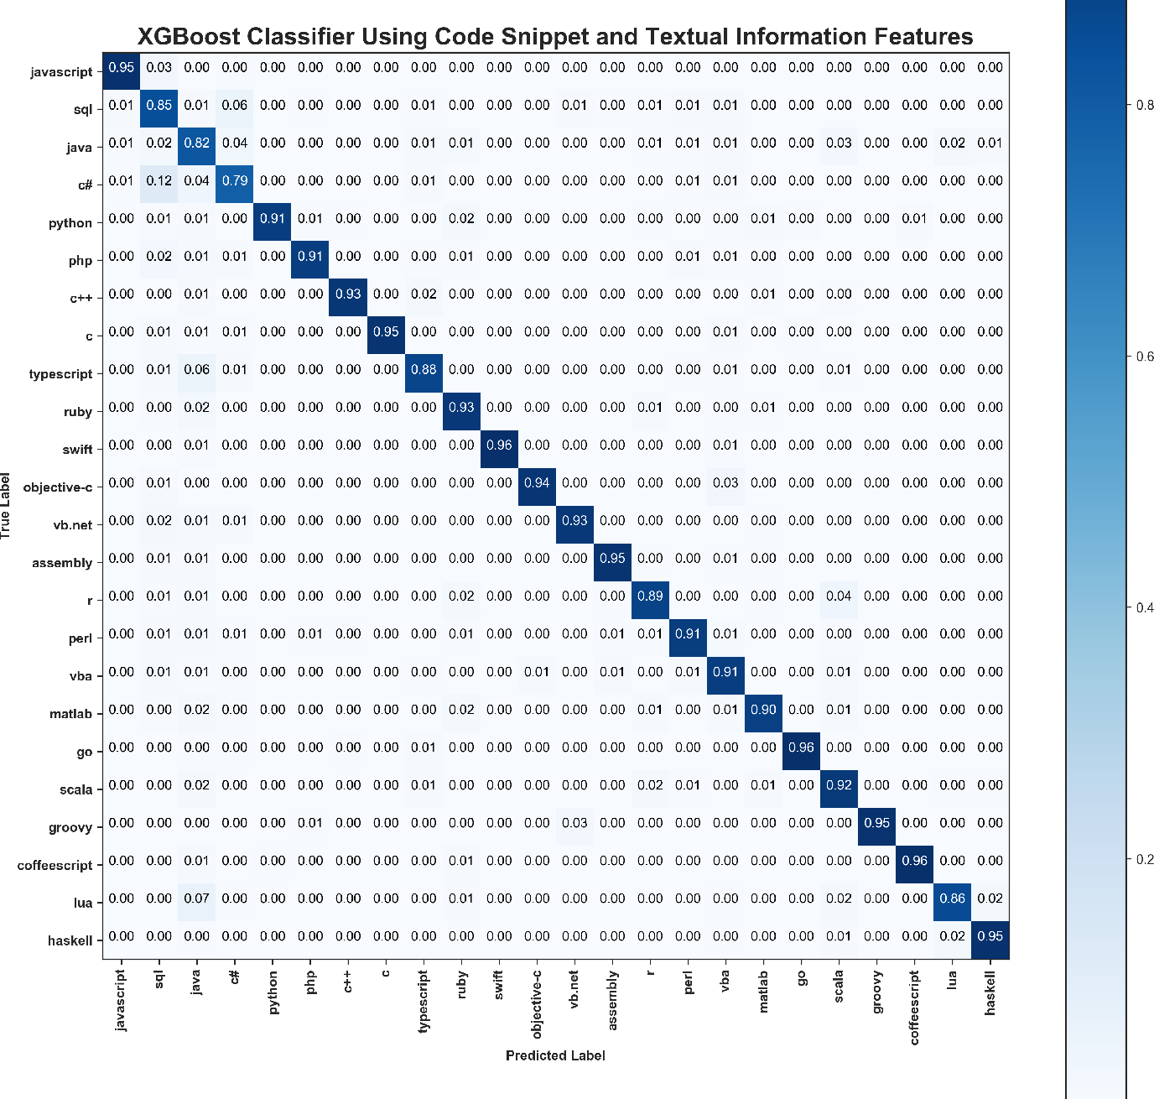
Results (continued)

Slide 31
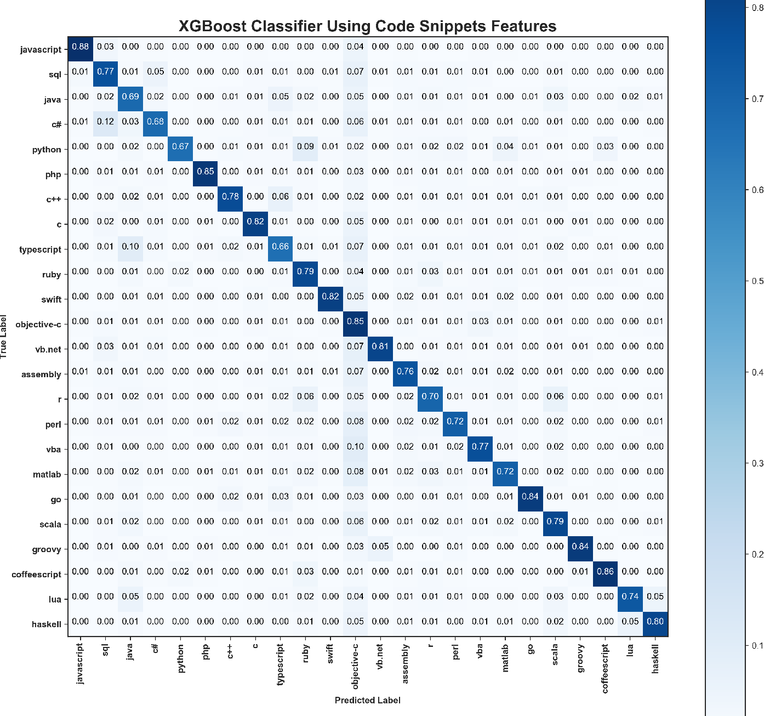
Results (continued)

Slide 32
Results (continued)
Significant improvement in performance compared to previous approaches
Dependency parsing and extracting entity names using a Neural Network (NN) through Spacy
reduce noise
extract important features

Slide 33
Results (continued)
Analysis of the feature space of the top performing languages
unique code snippet features (keywords/identifiers)
textual information features (libraries, functions)
Haskell: ‘GHC’, ‘GHCI’ (compilers), ‘Yesod’ (web-based framework) and ‘Monad’ (programming paradigm)
Most top performing languages have a small feature space
Java, Vba and C# have numerous libraries and standard functions having large feature space
A large feature space adds more complexity to the ML models

Slide 34
Shortcomings
Construct validity
Datasets were created based solely on programming language tags.
Language synonymous tags were left out.
For example, ‘SQL SERVER’, ‘PLSQL’ and ‘MICROSOFT SQL SERVER’ are related to ‘SQL’ but were discarded.
Internal validity
Dependency parsing to extract entity may result in the loss of critical vocabulary.
Selecting additional features such as lines of code and programming paradigm could have improved results but was not considered.
External validity
Stack Overflow was used in this study as the data source but other sources such as GitHub repositories were not explored.
Some common programming languages such as Cobol and Pascal were not considered in this study.

Slide 35
Conclusion & Future Work
This work tackles the important problem of predicting programming languages from code snippets and textual information.
NLP and ML techniques perform much better in predicting languages compared to tools that predict directly from code snippets.
Results show that training and testing the classifier by combining the textual information and code snippet achieves higher accuracy rather than using either textual information or code snippets only.
This classifier could be applied in scenarios such as code search engines and snippet management tools (Gists, Pastebin, QSnippets or Dash).
In future, the authors are planning to apply CNN combined with Word2Vec to evaluate programming blog posts, library documentation and bug repositories.

Slide 36
What I have learned reading this paper
NLP Techniques:
Tokenization
Stemming & Lemmatization
Named entity Recognition
ML Algorithms: RFC, XGBOOST
Tools used:
XMLTODICT: .xml data parsing
Beautiful Soup: extract text and code snippets separately
Spacy: Named entity recognition
NLTK library: Stemming and Lemmatization
Scikit Learn library
RandomSearchCV: Parameter tune
Tf-IDF vectorizer: Dataset split

Slide 37
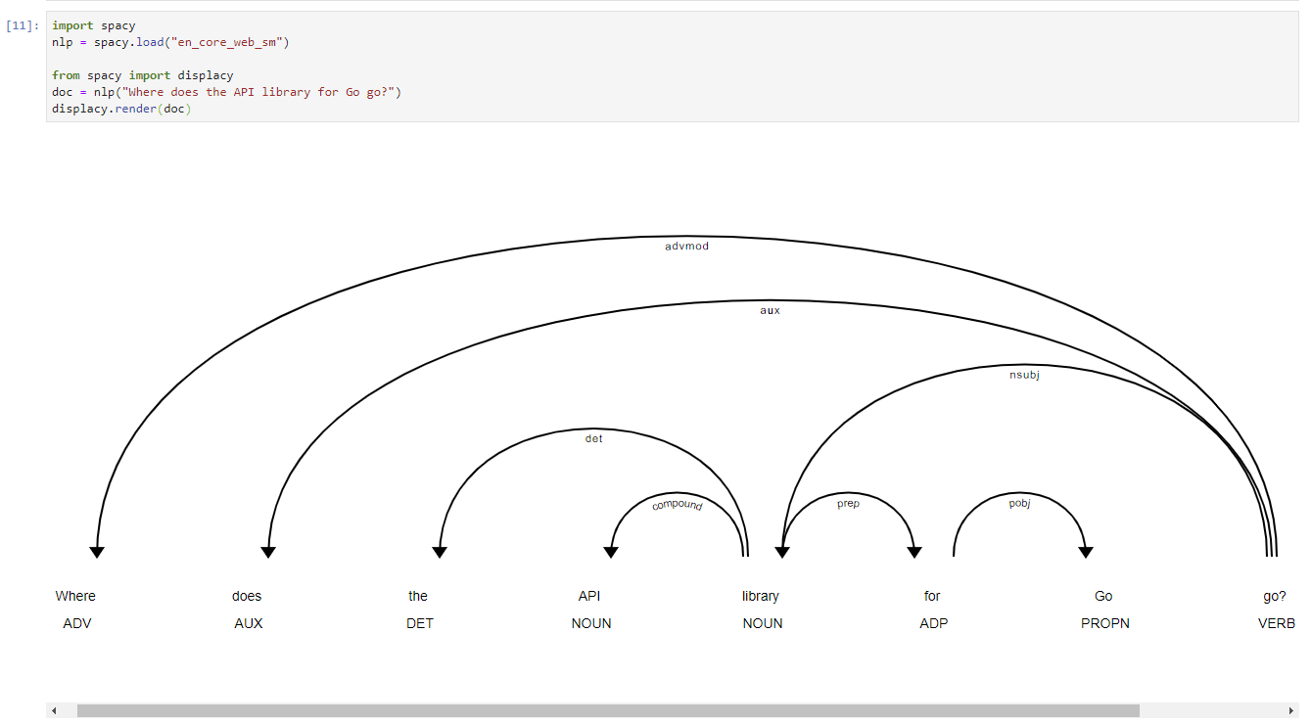
Spacy further explored

Slide 38
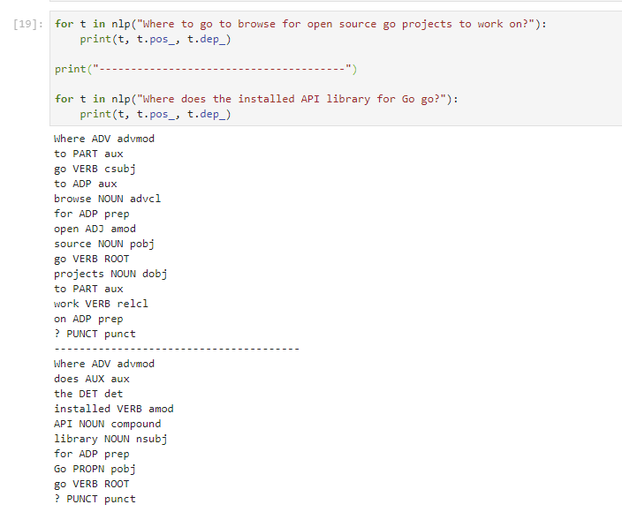
Spacy further explored

Slide 39
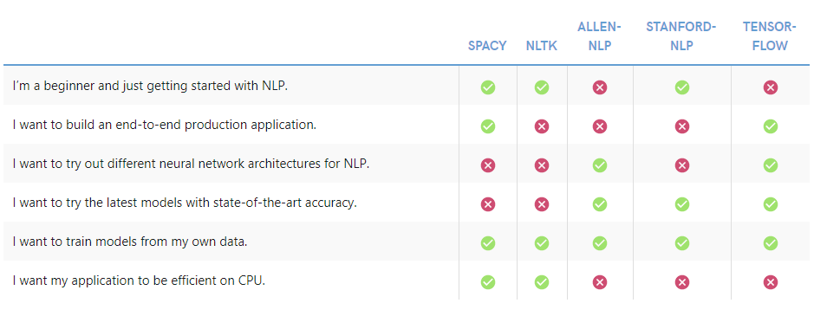
Spacy further explored

